Slide 1
Innovations in Applied Data Symposium
3 June 2021
Providing customised health intelligence in real-time – COVID-19 dashboards
Dr Uli Muellner Director (IT & Usability), Epi-interactive

Slide 2
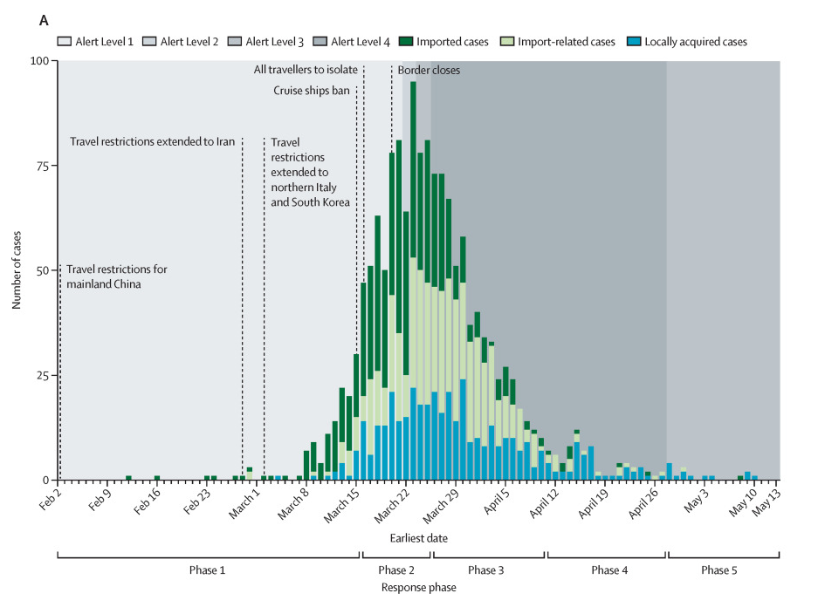
The challenge
To support NZ’s public health response to the pandemic it was important to enable easy access to health intelligence both to the general public and contributing stakeholders.
Jefferies S, French N, Gilkison C, Graham G, Hope V, Marshall J, McElnay C, McNeill A, Muellner P, Paine S, Prasad N, Scott J, Sherwood J, Yang L, Priest P. COVID-19 in New Zealand and the impact of the national response: a descriptive epidemiological study. Lancet Public Health, doi: 10.1016/S2468-2667(20)30225-5, 2020.
What we did
The COVID-19 dashboards were built for the Ministry of Health in collaboration with ESR building on ESR’s data and health intelligence capability (incl. EpiSurv).
Both a private dashboard that operates in real-time and a public dashboard were built to meet different information needs. The dashboards were released on 6 April – shortly after the border closed.
Once published, the dashboards and underlying data streams had to evolve as the response progressed e.g. to differentiate between cases occurring in the community and MIQ or to provide insight into identified outbreaks.

Slide 3
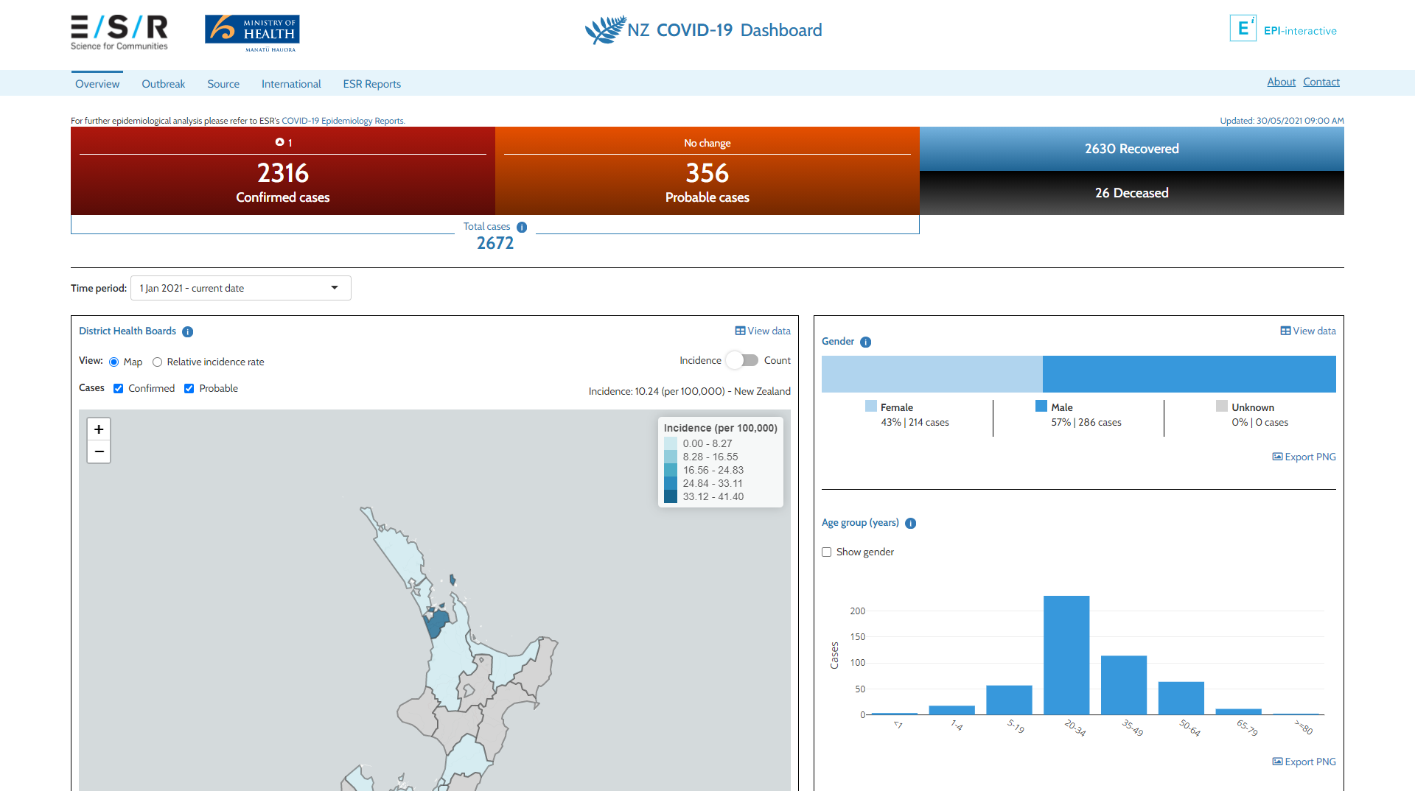

Access the dashboard at www.nzcoviddashboard.esr.cri.nz

Slide 4





Conclusions
Access the dashboard at www.nzcoviddashboard.esr.cri.nz
Using a R Shiny framework allowed us to dynamically adjust the dashboards to response requirements.
By pulling different skill sets together (IT, interface design, epidemiology, laboratory science…) we were able to make quick progress.
AWS cloud infrastructure supported on-demand scaling.
Contact for questions:
Dr Uli Muellner
uli@epi-interactive.com | www.epi-interactive.com
Thanks to our colleagues at ESR for a great collaboration and the Ministry of Health for funding this work.
The dashboards were jointly built with ESR’s COVID-19 response (special thanks to Mehnaz Adam, Andrew Crooke, Lisa Oakley, Andrea McNeill, Sarah Jefferies, Yvonne Galloway and Virginia Hope).
Aotearoa’s Full-Service RStudio partner

